Slide 1


SBI Churn Prediction Analysis
Certification in Data Analytics
DAB-15

Slide 2

INTRODUCTION
Customer churn is a major concern for banks, impacting revenue, profitability, and growth. This analysis examines churn patterns by evaluating key attributes like demographics, account details, service usage, and financial behavior. By integrating data, the study identifies critical churn drivers such as contract type, payment method, tenure, and monthly charges.
Understanding these factors helps uncover trends, predict churn risks, and implement targeted retention strategies. Key insights assist in segmenting customers, identifying high-risk groups, and optimizing services to enhance satisfaction.
Leveraging data-driven insights, banks can improve engagement, reduce churn, and strengthen their competitive position. This study provides a strategic foundation for boosting customer loyalty, increasing lifetime value, and driving sustainable growth.

Slide 3

Data Collection
Sources of Data: The dataset comprises four distinct files—Customer Information, Churn Records, Internet Usage, and the Telecom Churn Data Reference Guide. These files collectively provide critical insights into customer demographics, service usage, and churn behavior.
File Formats:
  TXT Files: Contain customer-specific details and churn history.
  CSV Files: Store structured data on internet usage and a reference guide defining variables and their significance.
Objective of Analysis: The purpose of this study is to examine customer trends, service utilization, and demographic influences to identify the primary reasons for customer churn. The results will facilitate the creation of data-driven retention strategies to minimize churn rates.

Slide 4
Data Cleaning in Excel & Create Master Data Sheet
Data Cleaning :-
  Handling Missing Values:
  1. Identified and addressed null values in the dataset.
2. Applied formulas to calculate Age and fill gaps in the Senior Citizen column.
3. Replaced missing values with computed data or "N/A" for consistency.
  Date Corrections:
  1. Eliminated invalid dates like 30th February.
  2. Ensured 29th February only appeared in leap years.
Master Data Sheet creation :-
I create the Master Data Sheet through combining Customer Data, Churn Data, and Internet Data using a common key like Customer ID. I use Power Query to merge all the datasets in Excel.

Slide 5




This SBI Churn Prediction Project analyzes customer churn trends using key metrics like churn percentage, tenure, contract type, payment method, and service distribution. It provides insights into customer retention, revenue impact, and churn drivers, helping optimize business strategies for improved customer loyalty and revenue growth.
Project Overview:-
Overall Metrics
Total Customer
Churn Rate
Average Tenure
Total Revenue
7043
26.54%
32.37
16.06M

Slide 6
Data Import, Cleaning & EDA in Python
Data Import & Inspection:
  Loaded the dataset from a CSV file into a Pandas DataFrame.
  Examined structure, data types, and distributions.
Handling Missing Values:
  Filled missing 'Total Charges' with 0.
  Replaced NaN’s in service-related columns('Multiple Lines,' 'Internet Service,’
  'Online Security,' 'Online Backup,''Device Protection,' 'Tech Support,' 'Streaming TV,' and
  'Streaming Movies.’) with "N/A.“
Data Transformation:
  Converted the 'Churn' column to numerical format (Yes → 1, No → 0).
Exploratory Data Analysis (EDA):
  Used visualizations like histograms, boxplots, and correlation heatmaps.
  Segmented data by key attributes to uncover churn drivers.

Slide 7
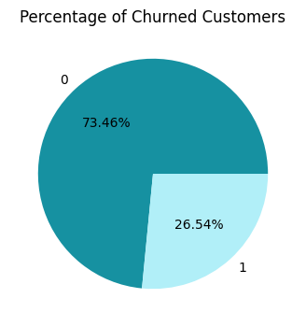
Customer Churn Percentage
This pie chart represents the proportion of customers who have churned (1) versus those who have remained (0).
73.46% of customers are retained (did not churn).
26.54% of customers have churned.
Conclusion:- With a 26.54% churn rate, retention is a concern. To reduce churn, focus on service improvements, loyalty incentives, and addressing customer concerns.

Slide 8
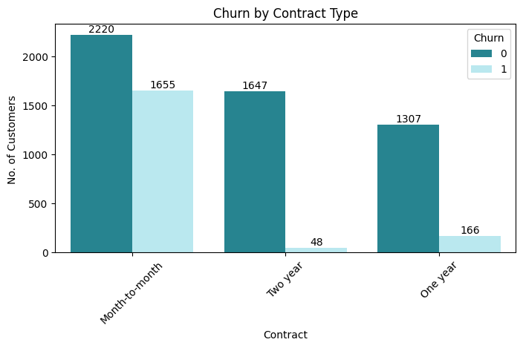
Churn by Contract Type
Month-to-Month contracts have the highest churn (1,655 customers).
One-Year contracts have significantly lower churn (166 customers).
Two-Year contracts have the lowest churn (48 customers).
Conclusion:- Short-term contracts lead to higher churn, while long-term commitments foster customer retention, indicating that offering incentives for extended contracts could improve retention rates.

Slide 9
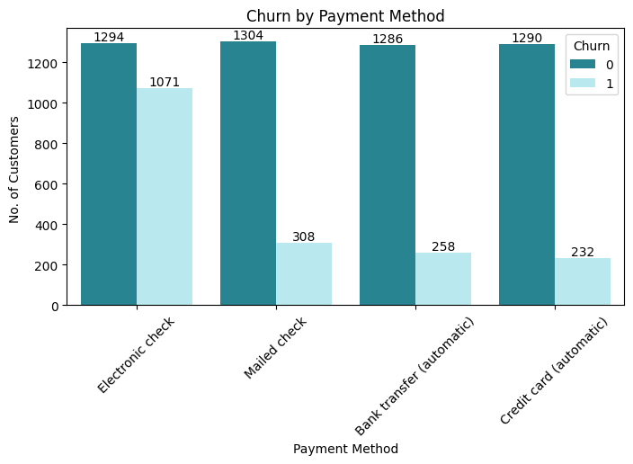
Churn by Payment Method
Electronic check users have the highest churn (1,071 customers).
Mailed check users have the moderate churn (308 customers).
Credit card & bank transfer (automatic payments) users have the lowest churn (232 & 258 customers).
Conclusion:- Customers paying via electronic checks are more likely to churn, while those using automatic payments (bank transfer or credit card) have a much lower churn rate. Encouraging customers to switch to automatic payment methods could help improve retention.

Slide 10
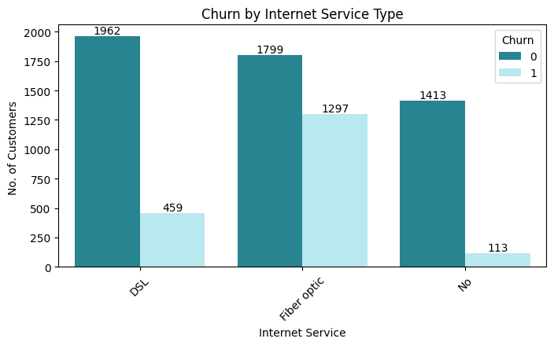
Churn by Internet Service Type
Fiber optic users have the highest churn (1,297 out of 3,096).
DSL users have the lower churn (459 out of 2,421).
No internet service has the lowest churn (113 out of 1,526).
Conclusion:- Fiber optic customers are churning at a much higher rate than DSL or those without internet service. The company should investigate service issues, pricing, or customer experience for fiber optic users to improve retention.

Slide 11
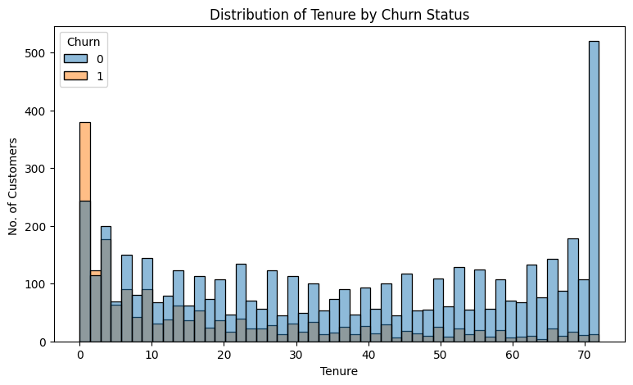
Distribution of Tenure by Churn Status
Tenure under 10 months has the most churn (noticeable orange bars).
Tenure between 10-60 months has moderate churn (even distribution).
Tenure over 60 months has least churn (dominantly blue bars).
Conclusion:- Customers with lower tenure are churning at a much higher rate than long-term customers. The company should focus on improving the early customer experience, addressing pain points, and enhancing retention strategies to reduce early churn.

Slide 12
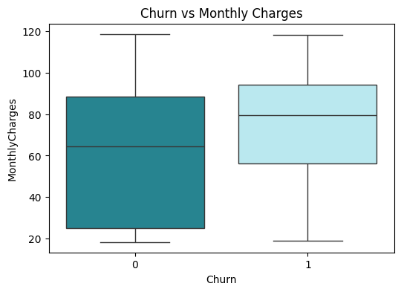
Churn vs Monthly Charges
Churned customers have higher median monthly charges.
Non-churned customers have wider range of monthly charges.
Conclusion:- Customers with higher monthly charges tend to churn more. The company should review pricing strategies or offer discounts to retain high-paying customers.

Slide 13
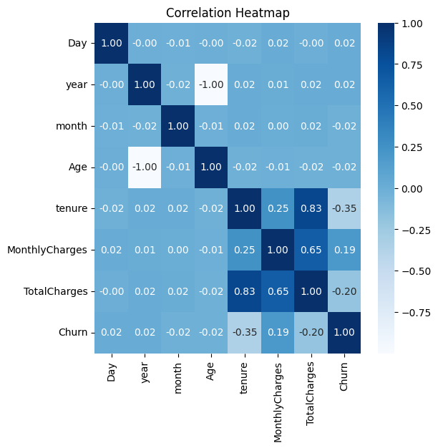
Correlation Heatmap
Tenure vs. Churn has a negative correlation (-0.35), longer tenure reduces churn.
Monthly Charges vs. Churn has Positive correlation (0.19), higher charges increase churn.
Total Charges vs. Churn has Negative correlation (-0.20), indicating retention over time.
Conclusion:- Customers with longer tenure are less likely to churn, while those with higher monthly charges are more likely to leave. The company should focus on retaining new customers and reassessing pricing strategies.

Slide 14
Recommendation to Reduce Customer Churn
I. Promote Long-Term Contracts :
Customers on one- or two-year contracts are 50% less likely to churn compared to month-to-month users.
Offering a 5-10% discount for switching to an annual plan can reduce churn by 15-20%.
II. Strengthen Early Customer Retention :
  Nearly 40% of churn occurs within the first six months.
  Introducing welcome bonuses or early loyalty incentives can lower early churn by 10-15%.
III. Tackle High Monthly Charges :
  Churn rates are 30% for customers paying over $70/month, while those paying under $50/month churn at less than 20%.
  Implementing customized pricing plans can reduce high-cost churn by 10%.
IV. Optimize Payment Methods :
  Customers using bank auto-pay have a 50% lower churn rate than those using electronic checks.
  A 5% discount for switching to credit card auto-pay can further cut churn by 5-10%.
V. Enhance Security & Service Bundles :
  Customers without security services experience a 35% churn rate, while those with such services churn at just 20%.
  Bundling security features with contracts can reduce churn by 10-15%.

Slide 15

CONCLUSION
The SBI Churn Analysis provides valuable insights into customer retention dynamics. The analysis highlights key factors influencing churn, such as contract types, billing methods, and pricing structures. Addressing these factors with targeted strategies can significantly improve customer retention rates. Implementing predictive analytics and proactive engagement approaches will enable telecom companies to enhance customer satisfaction and minimize churn. Overall, data-driven decision-making remains essential for maintaining a loyal customer base and sustaining business growth.

Slide 16

Thank You
- By Ayonika Dutta
Gmail- duttaayonika120@gmail.com

